Slide 1
Multiple inheritance in Java by interface
If an interface extends multiple interfaces is known as multiple inheritance.
interface
interface
extends
extends
interface

Slide 2
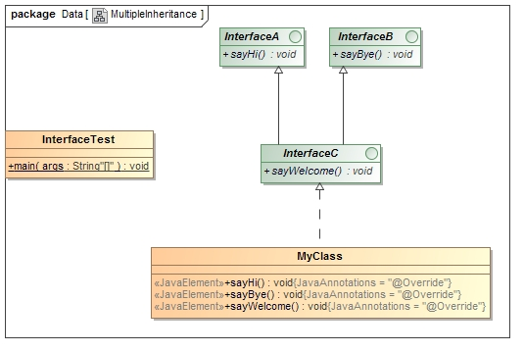
Multiple inheritance in Java by interface

